Slide 1
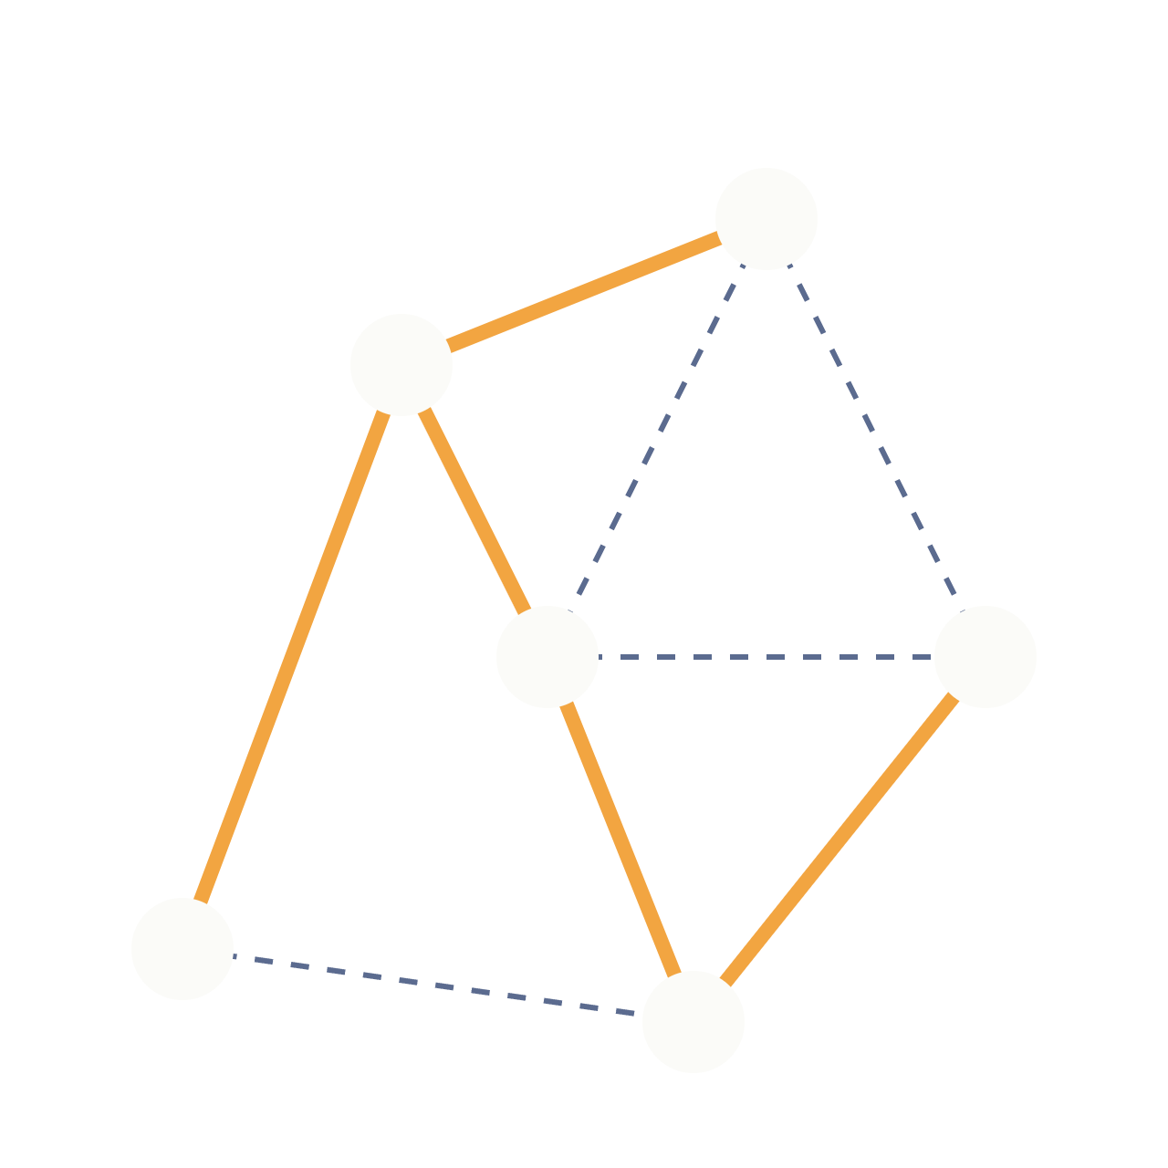
Kruskal’s
Algorithm
GRAPH ALGORITHMS · GREEDY METHOD
Building a minimum spanning tree by adding the cheapest edge that is safe, one edge at a time.
Notes:
Welcome. In this talk we cover what a minimum spanning tree is, how Kruskal’s algorithm builds one, the Union-Find structure that makes it fast, a worked example, and its complexity and uses.

Slide 2
What is a minimum spanning tree?
Given a connected, weighted, undirected graph, a spanning tree is a subset of its edges that links every vertex without forming a cycle.
Spanning
Tree
Minimum
Reaches every vertex, so the whole graph stays connected.
Contains no cycles, so it has exactly V − 1 edges for V vertices.
Among all spanning trees, its edge weights add up to the smallest total.
Kruskal’s goal: pick V − 1 edges that connect everything at the lowest possible total weight.
Notes:
A spanning tree touches every vertex using the fewest edges, V minus 1, with no cycles. The minimum spanning tree is the one whose total edge weight is smallest. Think of connecting towns with roads at the least cost.

Slide 3
The algorithm, step by step
1
Sort all edges by weight, smallest first.
PSEUDOCODE
2
Start with a forest in which every vertex is its own tree.
KRUSKAL(G)
T = {}
make_set(v) for every vertex v
Take the next edge. If its endpoints lie in different trees, add it. Otherwise skip it, since it would close a cycle.
sort edges by weight
3
for each edge (u, v, w):
if find(u) != find(v):
T = T + {(u, v, w)}
4
Stop once V − 1 edges are chosen or the edges run out.
union(u, v)
return T
Notes:
Kruskal’s is greedy: always consider the cheapest remaining edge. Sorting makes that easy. The only real question at each step is whether the edge joins two different trees, which is where Union-Find comes in. If the endpoints are already connected, the edge would create a cycle, so we skip it.

Slide 4
Union-Find: spotting cycles fast
Kruskal’s needs one question answered quickly: are these two vertices already connected? A disjoint-set structure answers it.
find(x)
union(a, b)
Two speed-ups
Follows parent links up from x to the root of its tree. Two vertices share a tree exactly when their roots match.
Hangs the root of one tree under the root of the other, merging two components into one.
Path compression flattens the tree during find. Union by rank hangs the shorter tree under the taller one. Together they make each call nearly constant time.
Notes:
Each vertex starts as its own set. find returns the representative root of a vertex’s set. If find(u) equals find(v), adding edge u-v would form a cycle. union merges two sets when we accept an edge. With path compression and union by rank, the amortized cost per operation is the inverse Ackermann function, effectively constant.

Slide 5
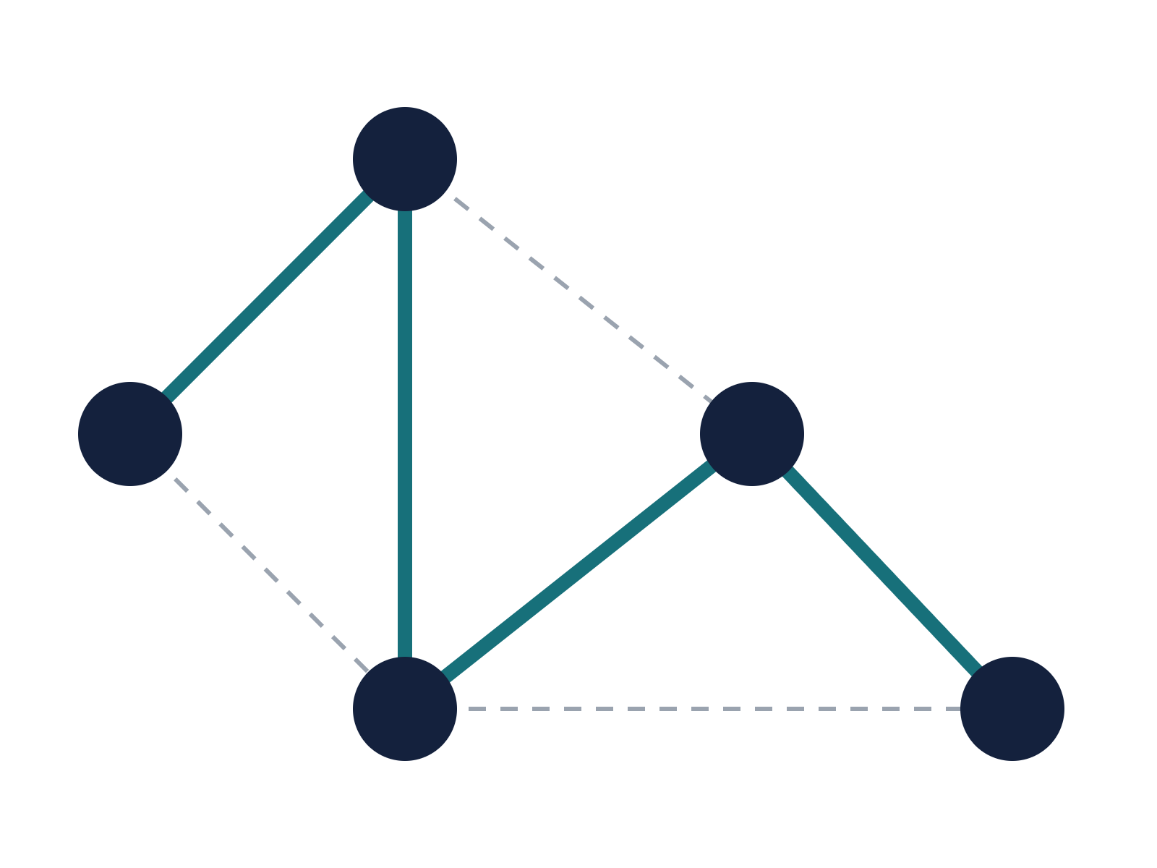
Worked example
Edge | Weight | Decision
A–B | 1 | Add
B–C | 2 | Add
A–C | 3 | Skip, cycle
C–D | 4 | Add
B–D | 5 | Skip, cycle
D–E | 6 | Add (4th edge)
C–E | 7 | Skip, tree complete
B
1
5
A
2
D
3
4
6
C
7
E
MST total weight: 1 + 2 + 4 + 6 = 13
Solid teal edges are in the tree. Dashed grey edges were skipped.
Notes:
Edges sorted by weight: A-B 1, B-C 2, A-C 3, C-D 4, B-D 5, D-E 6, C-E 7. We add A-B and B-C. A-C would connect two vertices already in the same tree, so it is skipped. C-D and D-E are added, giving four edges for five vertices. The remaining edges are skipped. Total weight is 13.

Slide 6
Complexity and correctness
O(E log E)
O(E α(V))
O(V + E)
Total running time. Sorting the edges dominates, and it equals O(E log V).
Cost of all find and union calls. α grows so slowly that it stays below 5 in practice.
Memory for the edge list and the disjoint-set arrays.
Why it is correct
Kruskal vs Prim
Cut property: for any cut of the graph, the lightest edge crossing it belongs to some minimum spanning tree. Each edge Kruskal accepts is the lightest one leaving its tree, so every greedy choice is safe.
Kruskal sorts edges and grows a forest, which suits sparse graphs. Prim grows one tree from a start vertex and is often faster on dense graphs. Both return a minimum spanning tree.
Notes:
Sorting costs E log E. The Union-Find work is almost linear. The proof of correctness rests on the cut property: the cheapest edge crossing any cut is safe to include. When two edges have equal weight, the tree may differ, but its total weight is always the same.

Slide 7
Where it is used, and what to remember
Applications
Key takeaways
Network design: cables, pipes and roads at minimum cost.
Clustering: stop early to get k groups of similar points.
Circuit and wiring layout with the least total wire.
Approximation heuristics for harder problems such as travelling salesman.
Sort the edges, then add each cheapest edge that closes no cycle.
Union-Find makes the cycle check almost constant time.
The result has V − 1 edges and the minimum total weight.
Total running time is O(E log E).
Notes:
To close: Kruskal’s is a clean example of a greedy algorithm that is provably optimal. It is widely used wherever you need to connect things cheaply, and it is also a building block for clustering. Remember the recipe: sort, check with Union-Find, add if safe, stop at V minus 1 edges.

